Slide 1
The emergence of the parish church: St Augustine to 1200
Richard Halsey
CHCT Conference April 5 2025

Slide 2
Roman Church
Three bishops at Council of Arles 314, Eborius (York), Restitutus (London) Adelfius (Lincoln)
N.B. before Christianity recognised by Constantine in 323
St Alban
Roman Christian soldier martyred long before 429 visit of Bishops Germanus and Lupus
Roman period Christian ‘churches’ at Silchester (Berks.), Lullingstone (Kent), Lincoln and London
British (Celtic) Church
St Ninian at Whithorn (south west Scotland) c.400, St Patrick in Ireland 432
St Columba at Iona (west Scotland) 565, St David (south west Wales) c. 580,
St Kentigern (Mungo) Glasgow d.612, St Asaph, north Wales c.600

Slide 3
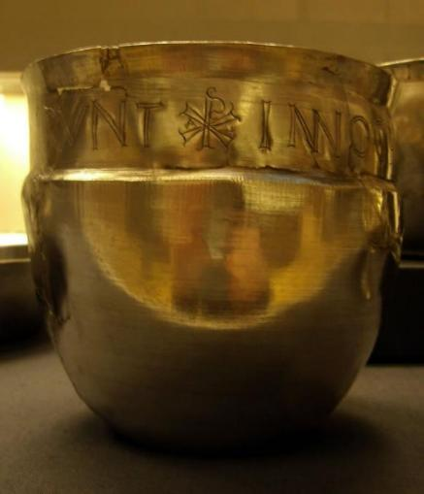
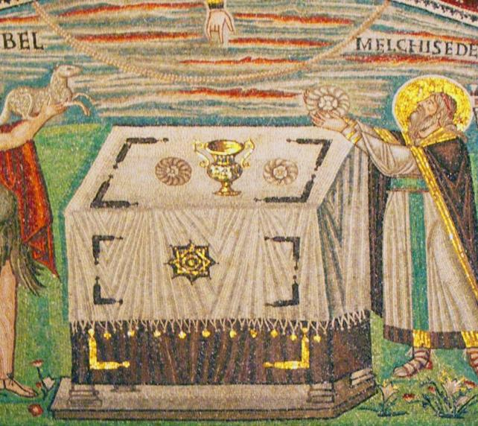
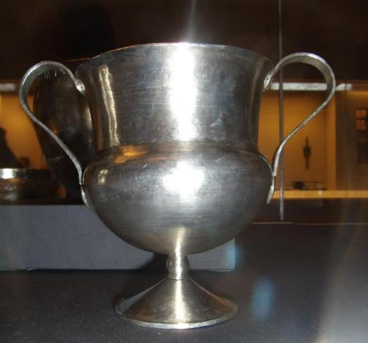
Water Newton Hoard
c. 350-c.400
just outside Durobrivae
Roman garrison
Hanging bowl with Chi Rio
Cantharus (chalice)
C6th Ravenna San Vitale mosaic c. 700 showing chalice on a dressed altar which has corner legs

Slide 4
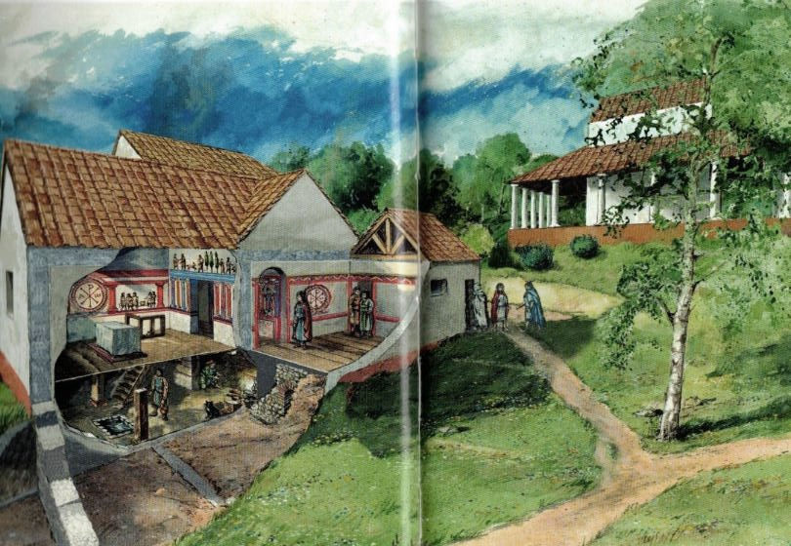
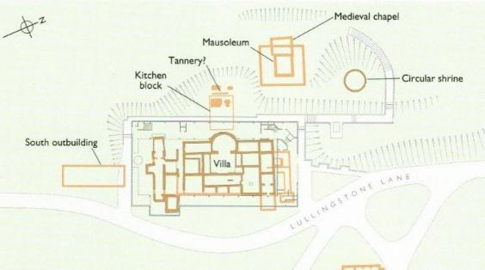
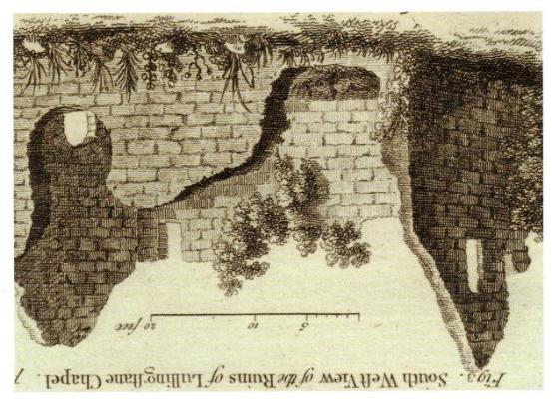
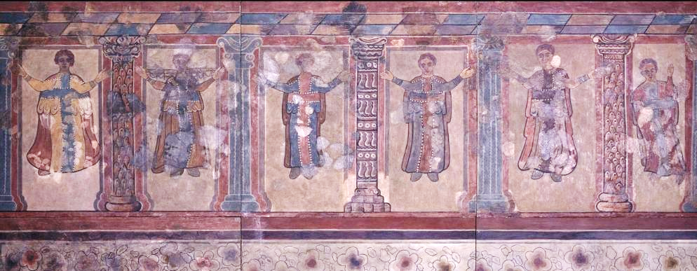
Lullingstone Roman Villa, Kent
house church of late C4th
House church
Wall paintings now in British Museum
Images from English Heritage
Guidebook

Slide 5
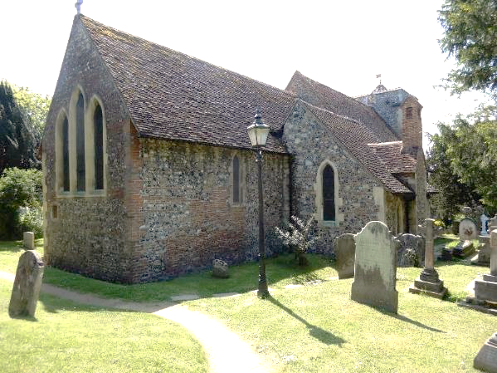
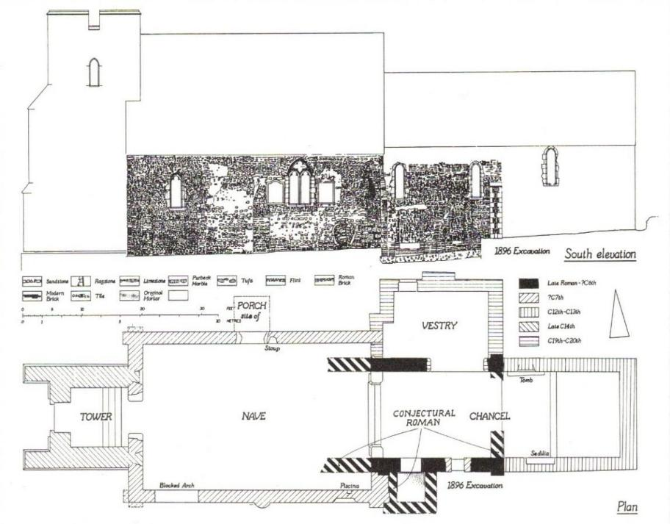
Canterbury, St Martin - the oldest UK Christian church in continuous use for worship?
‘On the east side of the city stood an old church,
built in honour of Saint Martin during the Roman
occupation of Britain, where the Christian queen
[Bertha] went to pray….and to practice her faith
unhindered with Bishop Liudhard’
Bede A History of the English Church and People

Slide 6
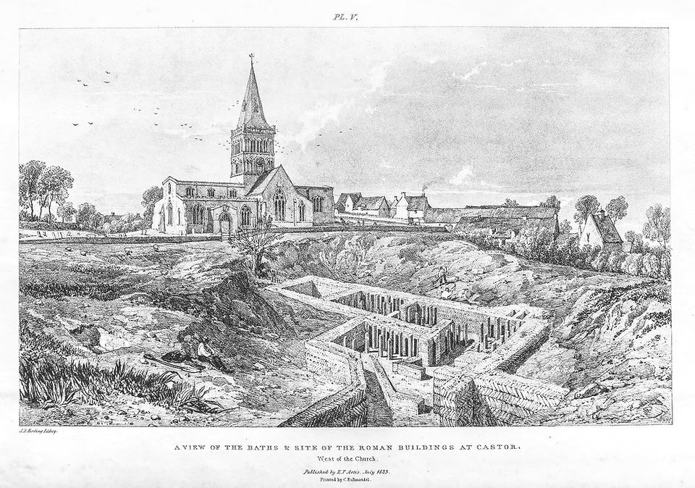
Castor church near excavated ruins of Durobrivae 1823

Slide 7
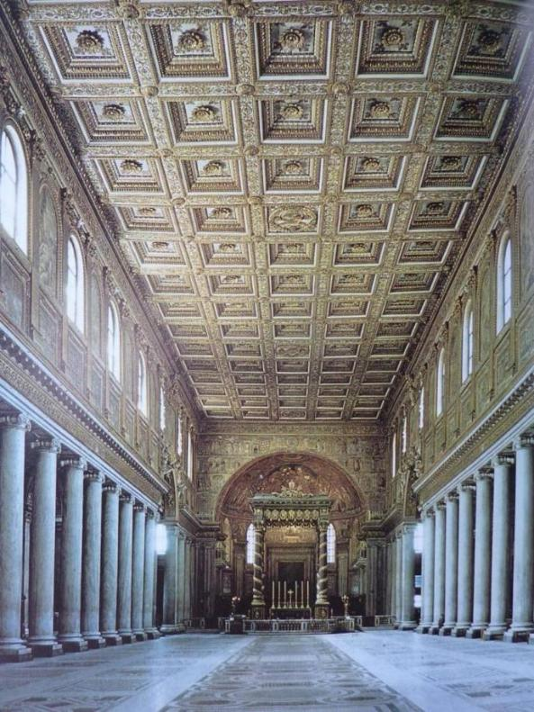
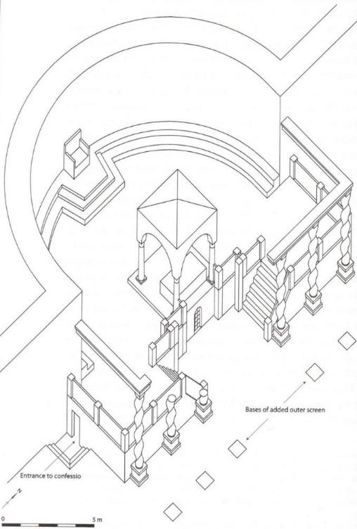
Rome
Basilica of St Maria Maggiore c.540
St Peter
c.600 sanctuary
© R Gem

Slide 8
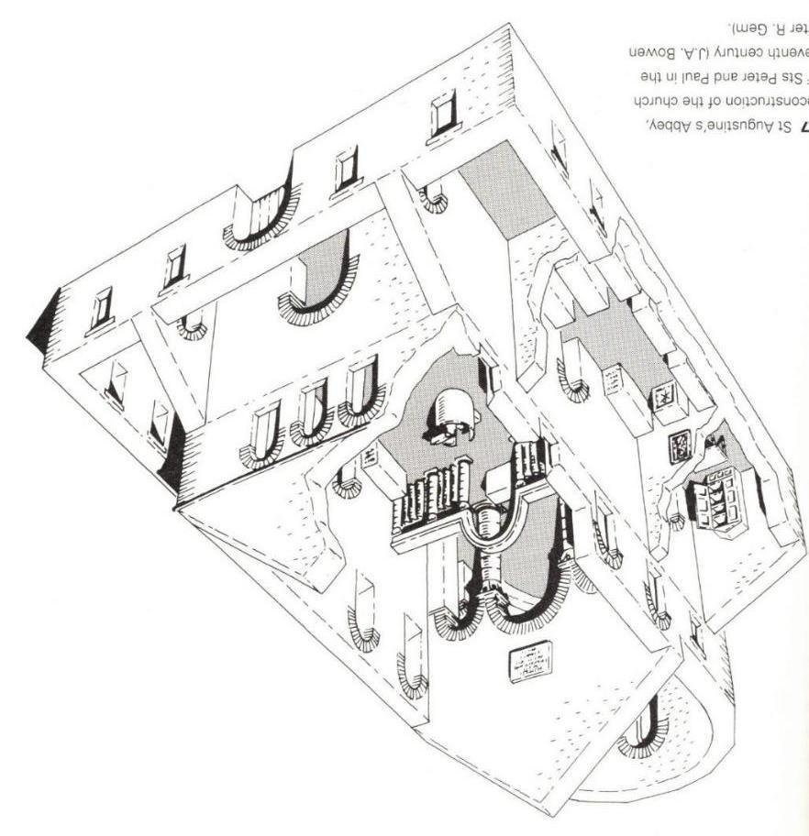
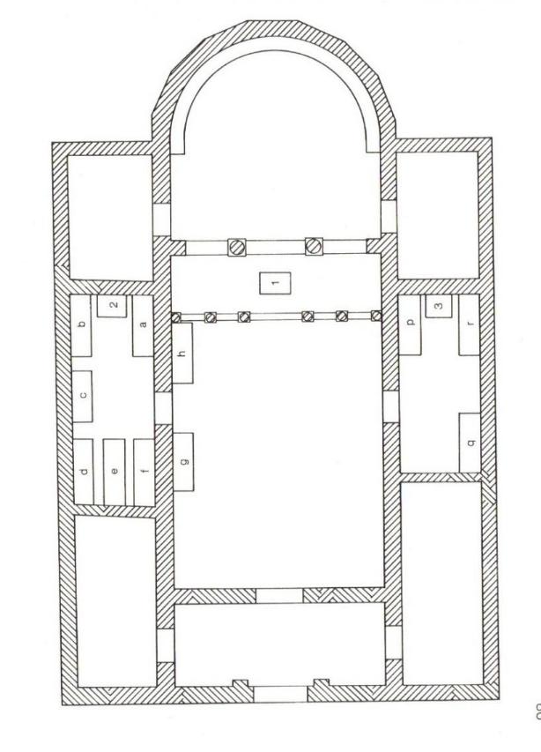
Canterbury, Abbey church of St Peter and St Paul (now St Augustine’s)
c.600
‘porticus

Slide 9
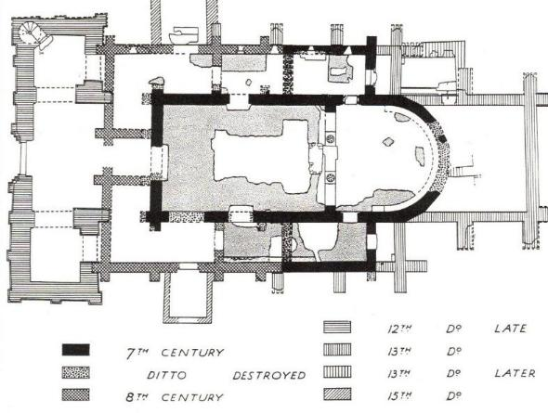
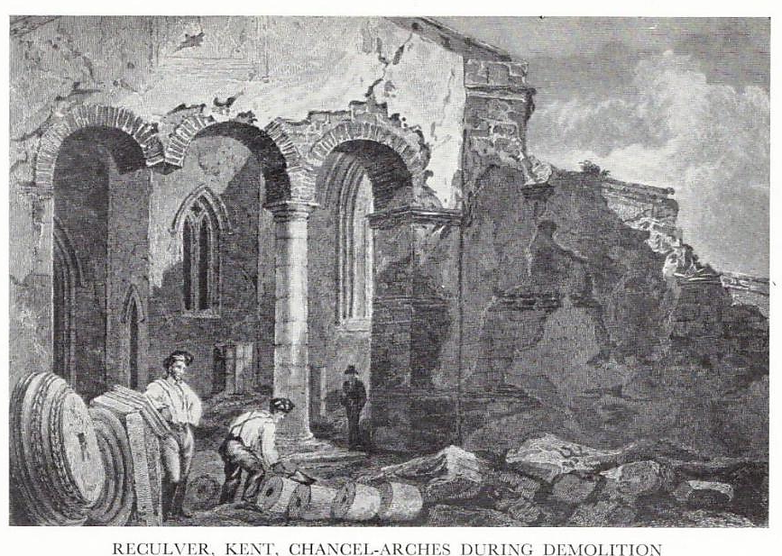
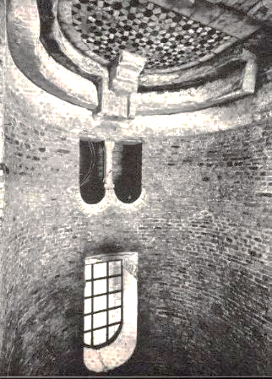
Reculver Kent,
Monastery f. 669 within Richborough Roman Saxon Shore fort, a parish church by Domesday 1086 and demolished in 1805
Synthronun
(priest’s bench)
Sta Maria della Grazie
Grado, c. C5th

Slide 10
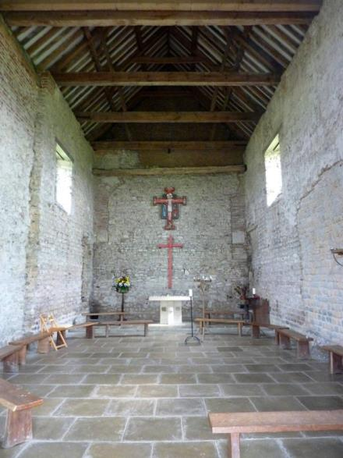
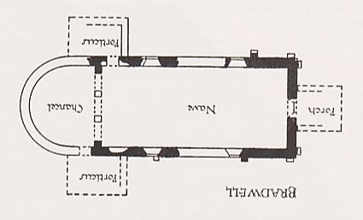
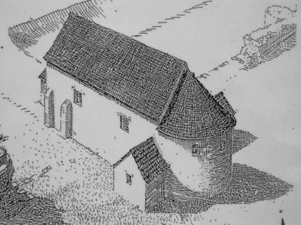
Bradwell-on-Sea (Essex), founded within the Roman fort Othona by St Cedd 653-664
reconstruction
interior to east

Slide 11
What do we mean by ‘parish church’?
Non-monastic consecrated buildings where the sacraments, Mass, baptism and burial are conducted, most especially the latter two. Perhaps the singing of psalms and preaching take place?
Two types of non-monastic church pre-1100
Minsters essentially a group of priests living together (but not necessarily following any Rule) with responsibility for a ‘parochia’ which originally may have been coterminous with the estate of the King, nobleman or ecclesiastic who had created it. Minsters alone had the right to baptise and bury, for a fee. Some priests travelled to local chapels to conduct Mass.
‘Proprietary Churches’ or ‘Field-chapels’ were established by local landowners, often next to their residence, partly for convenience – their ‘chaplain’ could say Mass – but especially as a symbol of their status. The Codes of King Edgar (959-75) consolidated the rights of minsters to receive ‘churchscot’ or the tithes from their parochia and enabled landowners to divert some of their own tithes for the maintenance of their local church and priest.
Both minsters and field churches gradually became parish churches under diocesan control from the later C11th as the Normans re-organised the country and the Church consolidated its control, but some minsters, particularly those owned by a hereditary clerical family, survived until the end of the C12th. Many churches i.e. their tithes, were then given to monasteries, who funded a vicar, approved by the Bishop, to be the parish priest.

Slide 12
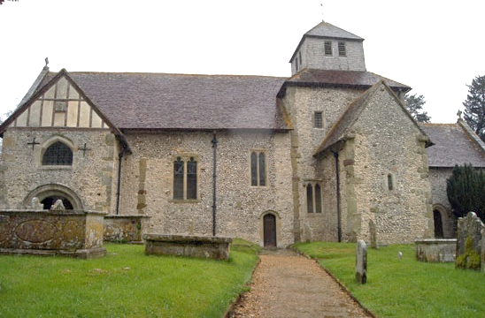
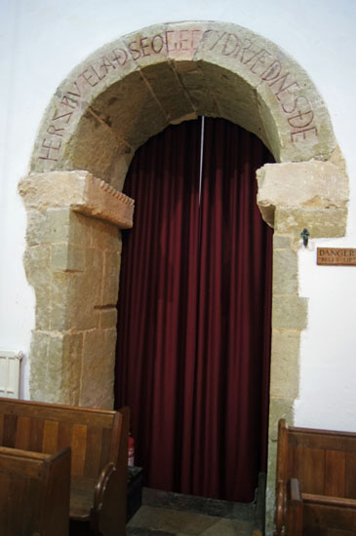
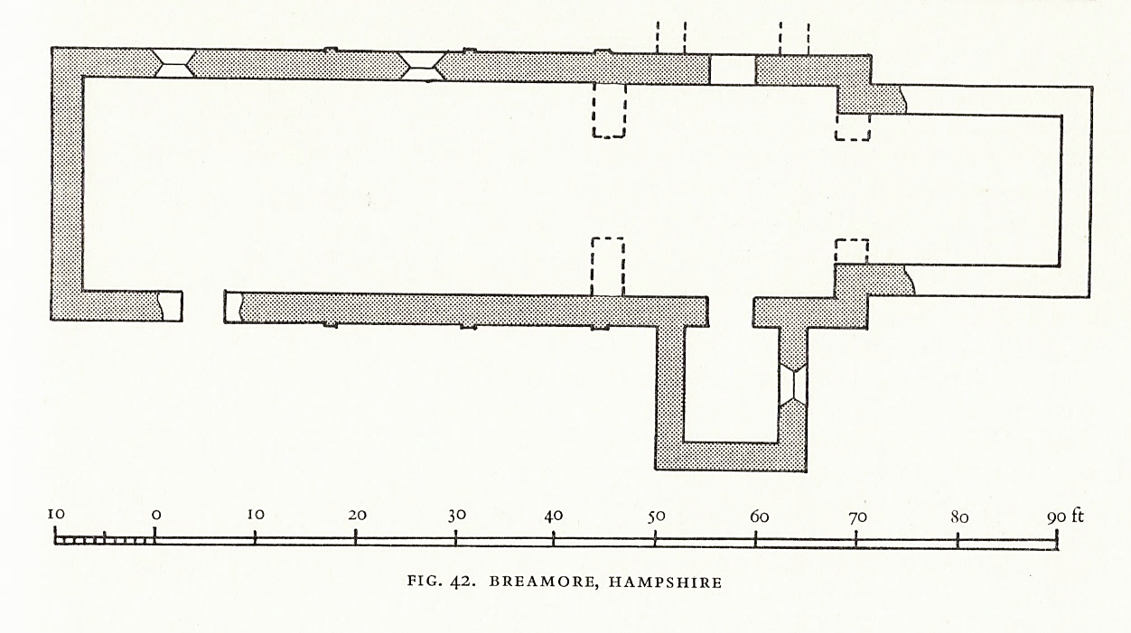
Breamore, Hants., c.1000 cruciform minster church
‘Here is made manifest the Covenant to you’
the rainbow of the
Covenant between God
and Noah?
Or the New Covenant as provided by baptism in the
font in the porticus beyond?

Slide 13
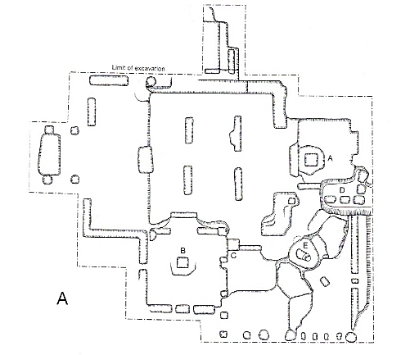
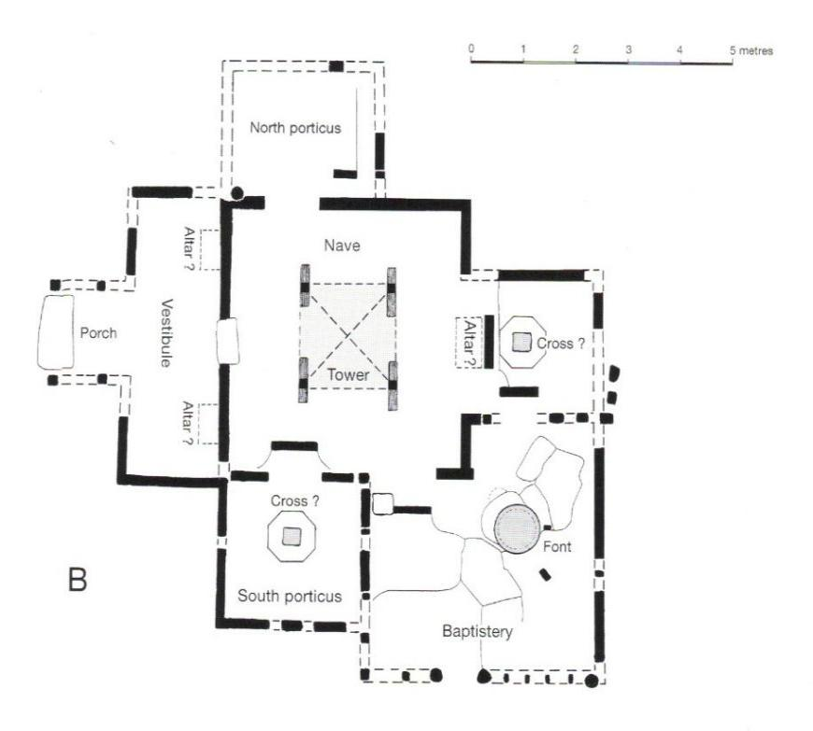
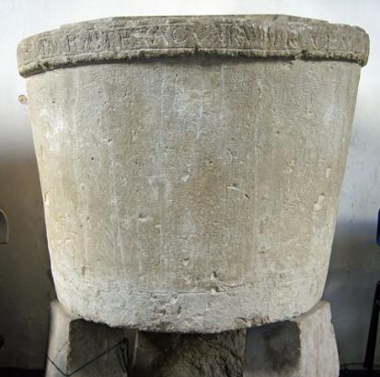
Potterne Wilts., excavated C11th timber church
© Warwick Rodwell
C9-11th font
rim inscription from Ps.14

Slide 14
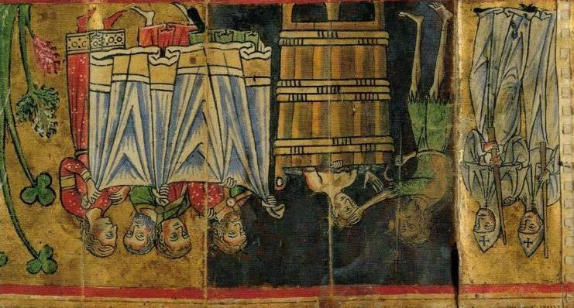
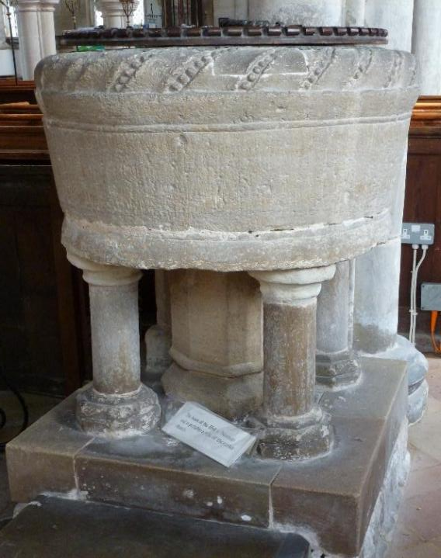
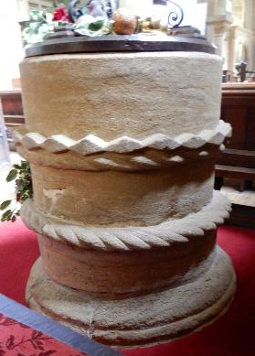
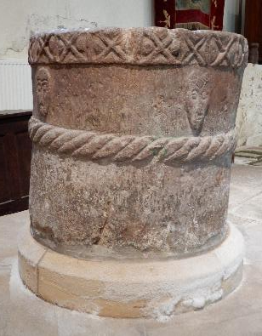
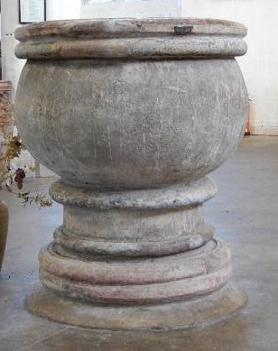
Guilden Morden (Cambs.)
John the Baptist baptising Christ
© British Library Add. Ms 42497, f.3, France late C12th
‘tub-font’
Stoke-sub-Hamdon & Stogursey (Somerset), Heydon (Norfolk)

Slide 15
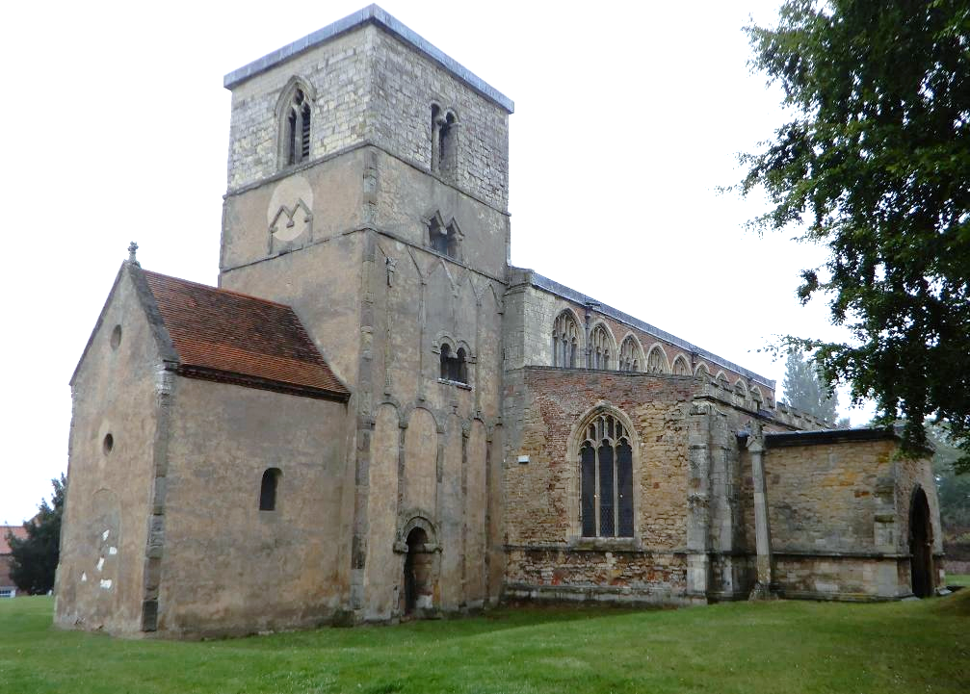
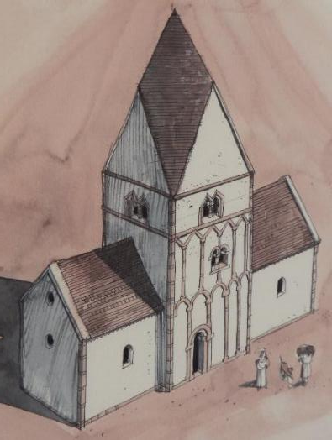
Barton-on-Humber, St Peter c.1000, tower nave church
English Heritage reconstruction

Slide 16
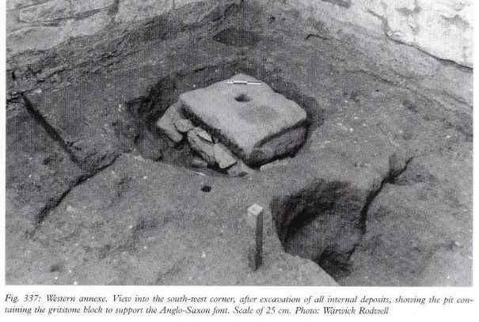
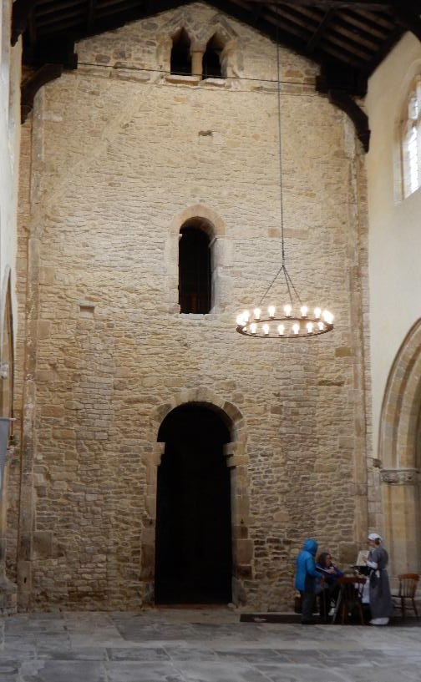
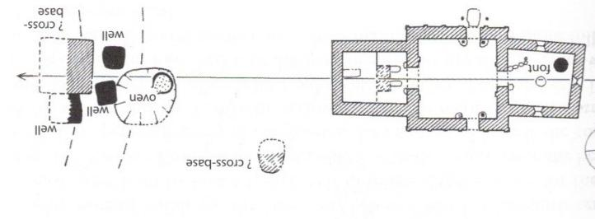
Barton-on-Humber, St Peter c.1000
east face of tower with ‘chancel arch’

Slide 17
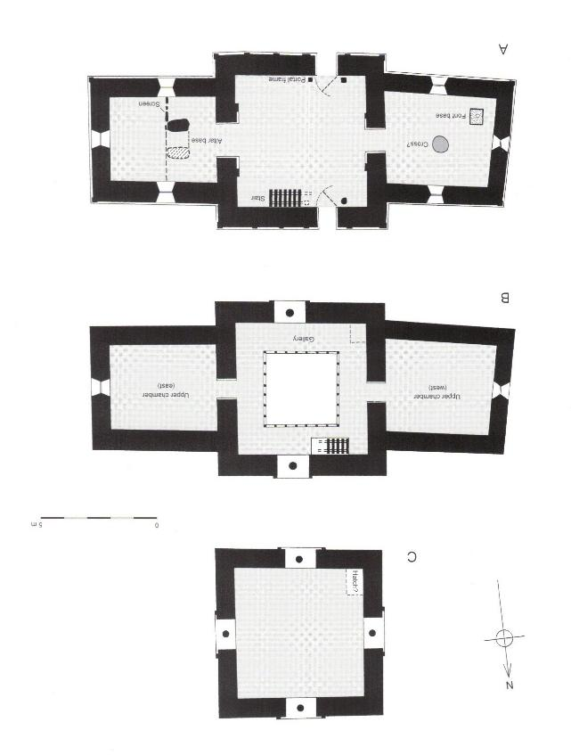
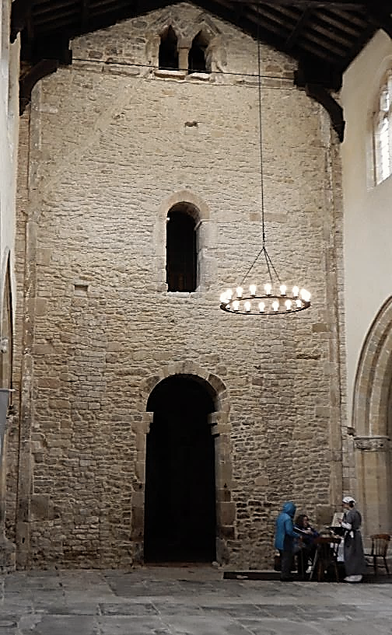
Barton-on-Humber, St Peter c.1000
c.1000 chancel
tower floor plans (©Warwick Rodwell)

Slide 18
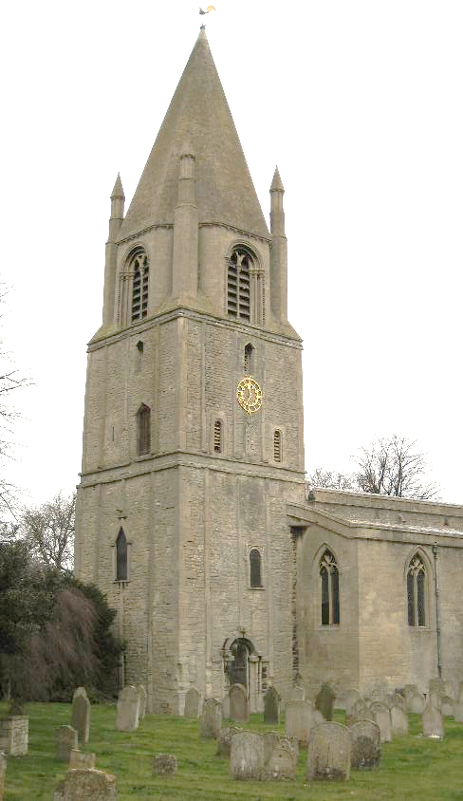
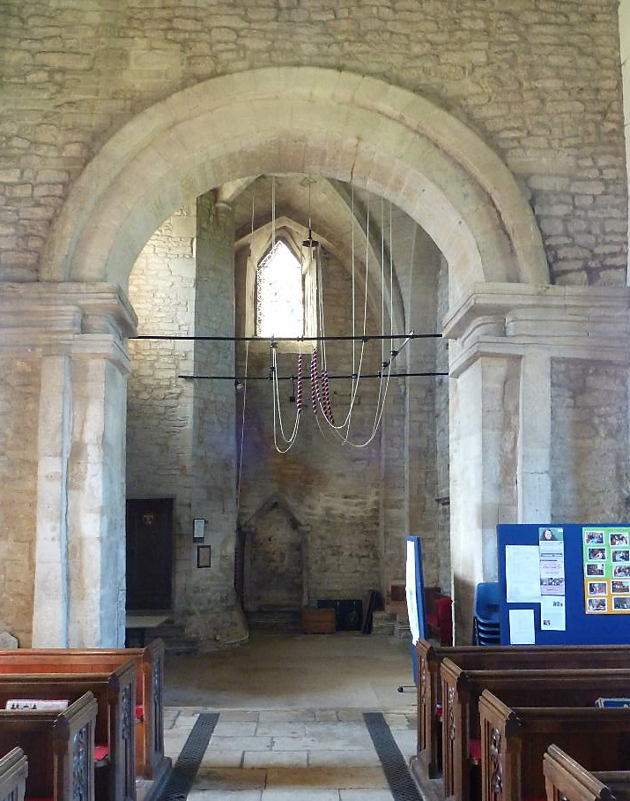
Barnack, (Cambs.) c.1000-25

Slide 19
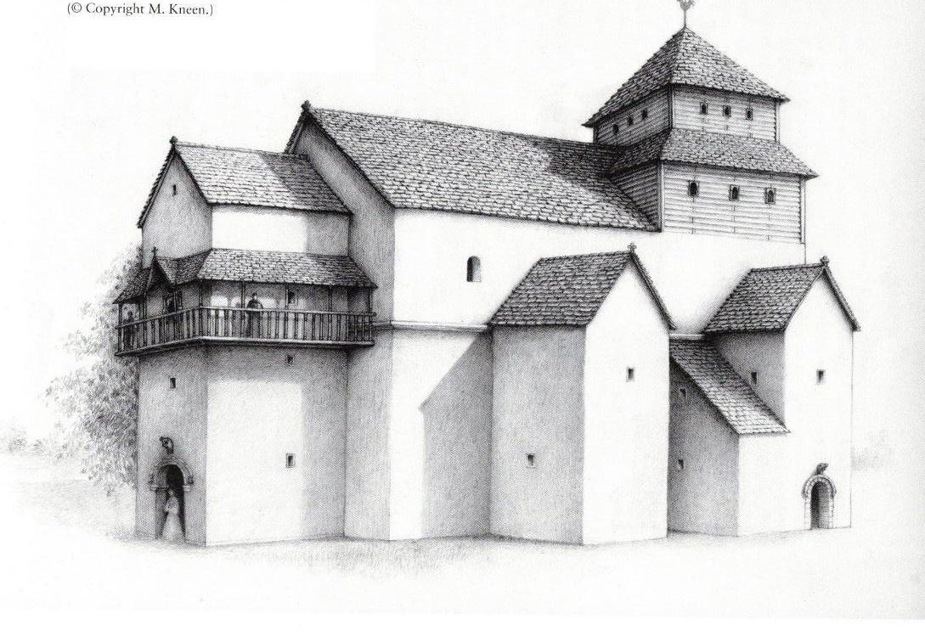
Deerhurst, Gloucs. minster church c.800

Slide 20
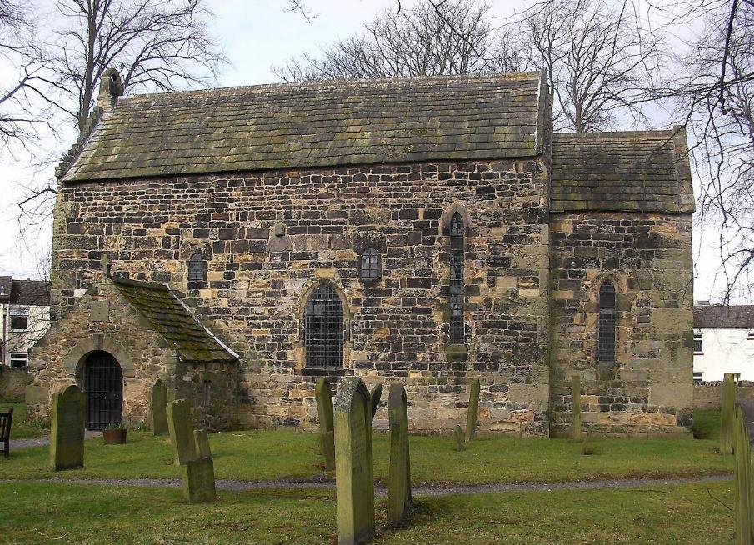
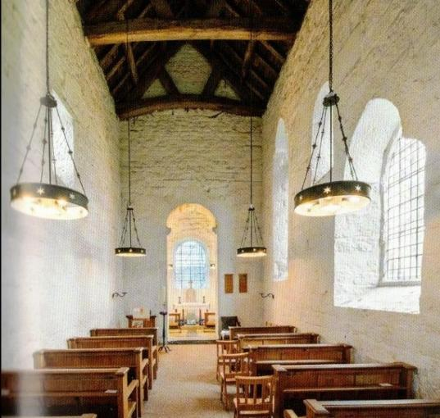
Escomb Co. Durham late 8th century
Toonbear, CC BY-SA 3.0 <https://creativecommons.org/licenses/by-sa/3.0>, via Wikimedia Commons
from Buildings of England, Co. Durham

Slide 21
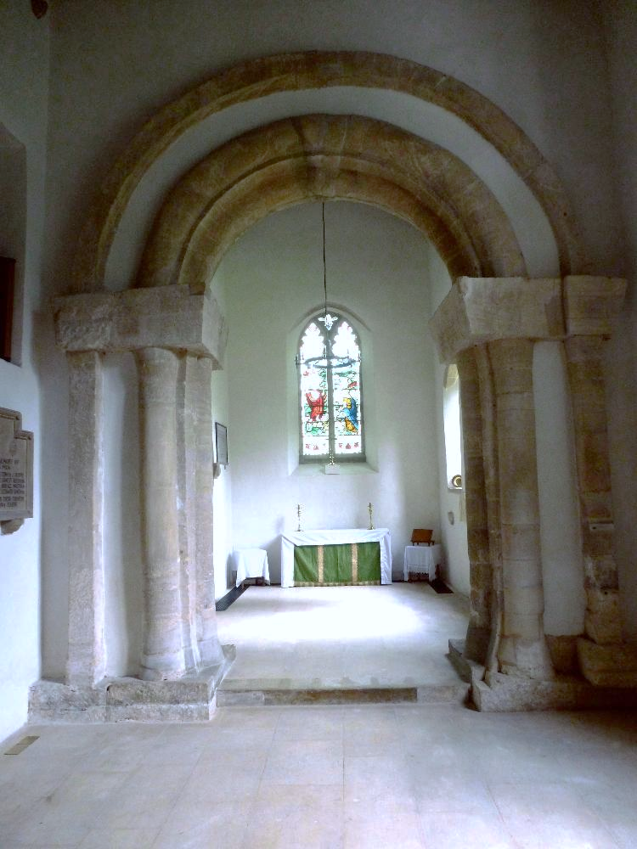
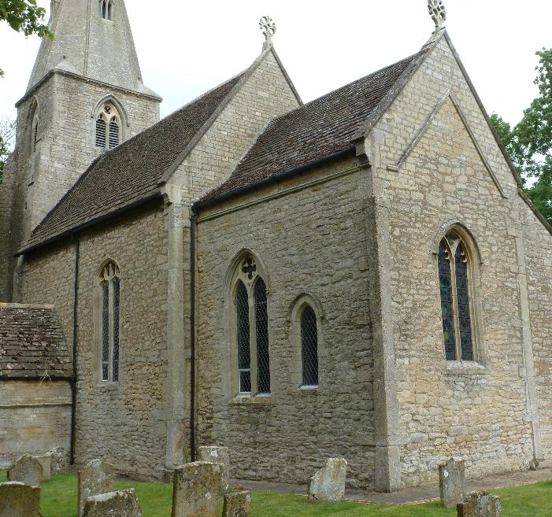
Wittering, Hunts.,
‘overlap’ late C11th

Slide 22
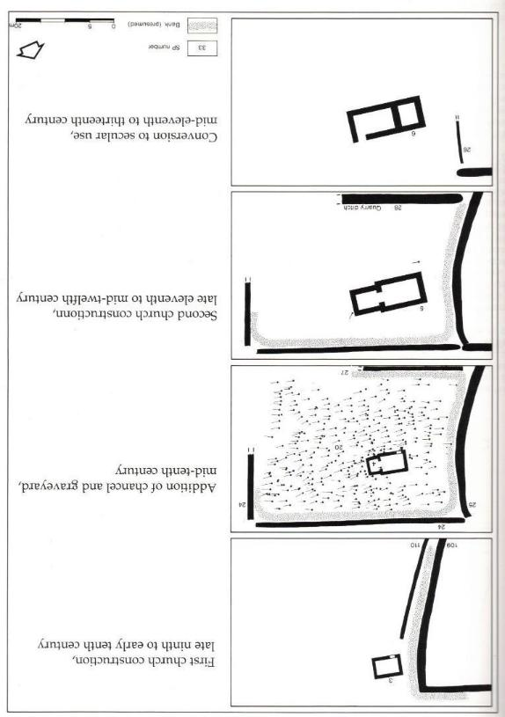
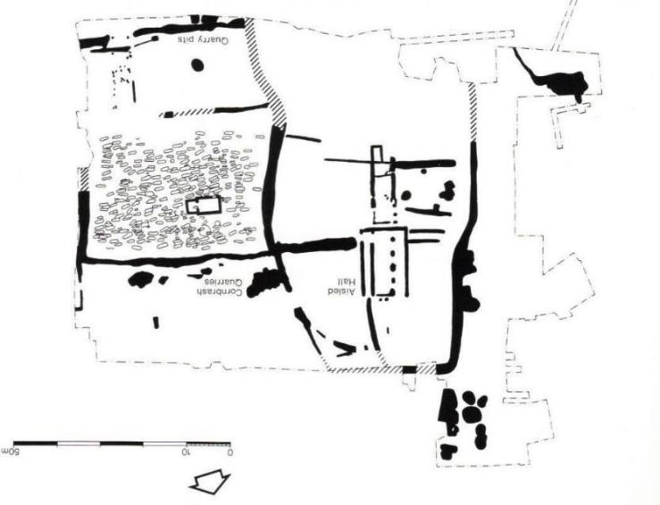
Raunds Furnells, Northants.
Excavation Report, Andy Boddington (1996)

Slide 23
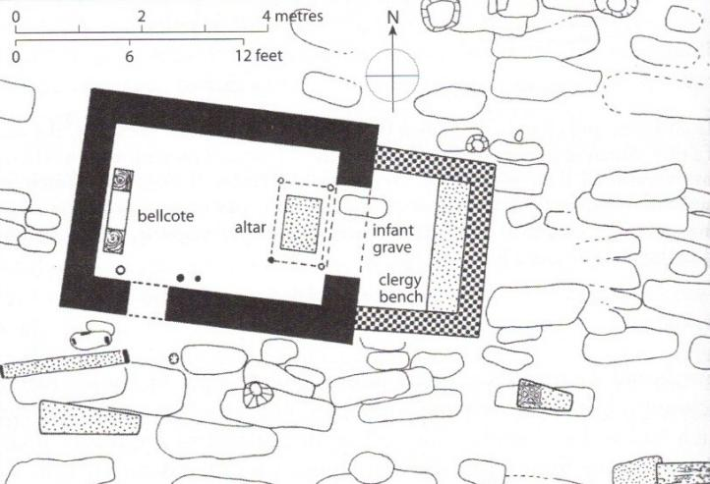
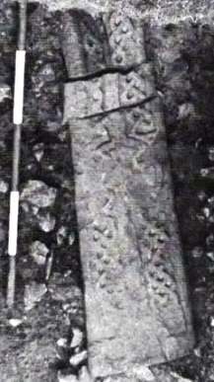
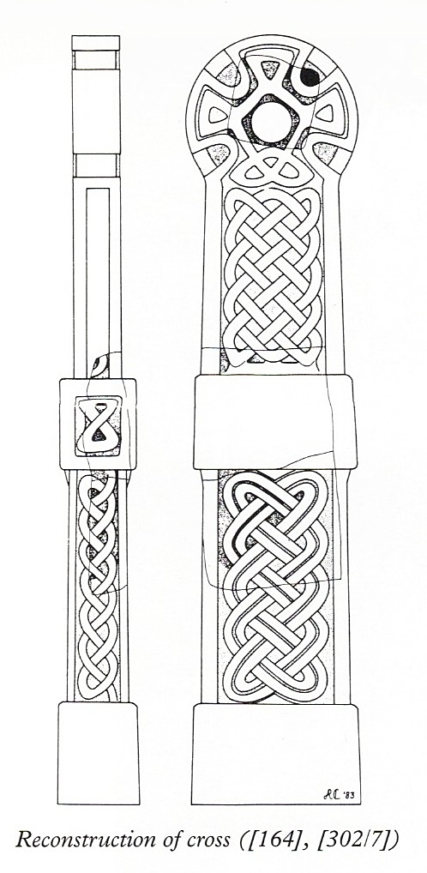
Raunds Furnells, Northants., second church plan, c.1000
founders coffin cover
Bishop consecrating
a church c.970-80
Benedictional of St Aethelwold
BL Add. Ms 49598 f.118v
grave marker

Slide 24
Hopperstad, Norway, c.1130-50
reconstruction of late medieval interior
early C13th altar canopy

Slide 25
Isleham Priory, Cambs., c.1100 apse
Barton Bendish
St Andrew, Cambs.
C14th single piscina bowl
above double floor drain

Slide 26
Raunds Furnells, Northants.
history of buried pot, likely
used as a sacrarium and piscina
c.950
c.1000

Slide 27
Swannington, Norfolk
c.1130 pillar piscina bowl re-erected against a C14th niche piscina
in mid-C20th

Slide 28
Parish church plans c.1070-1150
Moccas, Herefs.
c.1130

Slide 29
Moccas, Herefs.
decorated door and arches to the chancel and sanctuary/apse

Slide 30
Duxford St John, now Churches Conservation Trust
Three cell C12th church with central tower, entered by opposing nave doors. No west door
Duxford St Peter
Three cell C12th church with west tower,
also entered by opposing nave doors, no
west door
(nave rebuilt with aisles in C15th)

Slide 31
Duxford, St Peter, west tower arch
Duxford St John
central tower arches

Slide 32
tower
chancel
Duxford St Peter, eastern tower arch (so the arch to the chancel)
Agnus Dei supported by angels

Slide 33
Little Faringdon, Oxon.
North aisle added to Romanesque
church c.1200

Slide 34
Soham, Cambs., c.1200 aisled nave and crossing tower

Slide 35
Canterbury Cathedral
north choir aisle c.1200
Christ leading the gentiles away from idolatry
c.1150 altar (France)

Slide 36
Hook Norton, Oxon.,
mid-C12th piscina
Fowlmere, Cambs.,
piscina half way along south
chancel wall, C12th?

Slide 37
Durandus, a C13th French bishop, wrote on the symbolism of church architecture and liturgical objects and the rituals of worship, the Rationale divinorum officiorum
20. The grating [i.e. perforated screen] that divides the altar from the choir signifies the separation of the celestial from the terrestial realm
21. Near the altar which signifies Christ, a basin or small tub is placed which represents Christ’s mercy, in which his [i.e. the priest] hands are washed to show that in Baptism or Penance we are cleansed of the filth of our sins.

Slide 38
Bourges Cathedral north ambulatory
c.1210-15 Discovery of St Stephen’s relics
free-standing
piscina?
Canterbury Cathedral, north choir aisle
c.1190-1200 King Jeroboam’s sacrifice

Slide 39
Attached piscina bowls
South Lopham Norfolk, re-used as a quoin
Carrow Priory, Norwich, f.c.1150
excavated piscina bowl

